Slide 1
All Things Reactive – a peek into Reactive Java Slides :: 2019 Mary Grygleski Twitter: @mgrygles IBM Developer Advocate Java & Reactive Grant Steinfeld Twitter: @gsteinfeld IBM Developer Advocate JVM & Blockchain

Slide 2
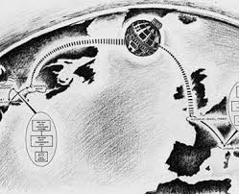
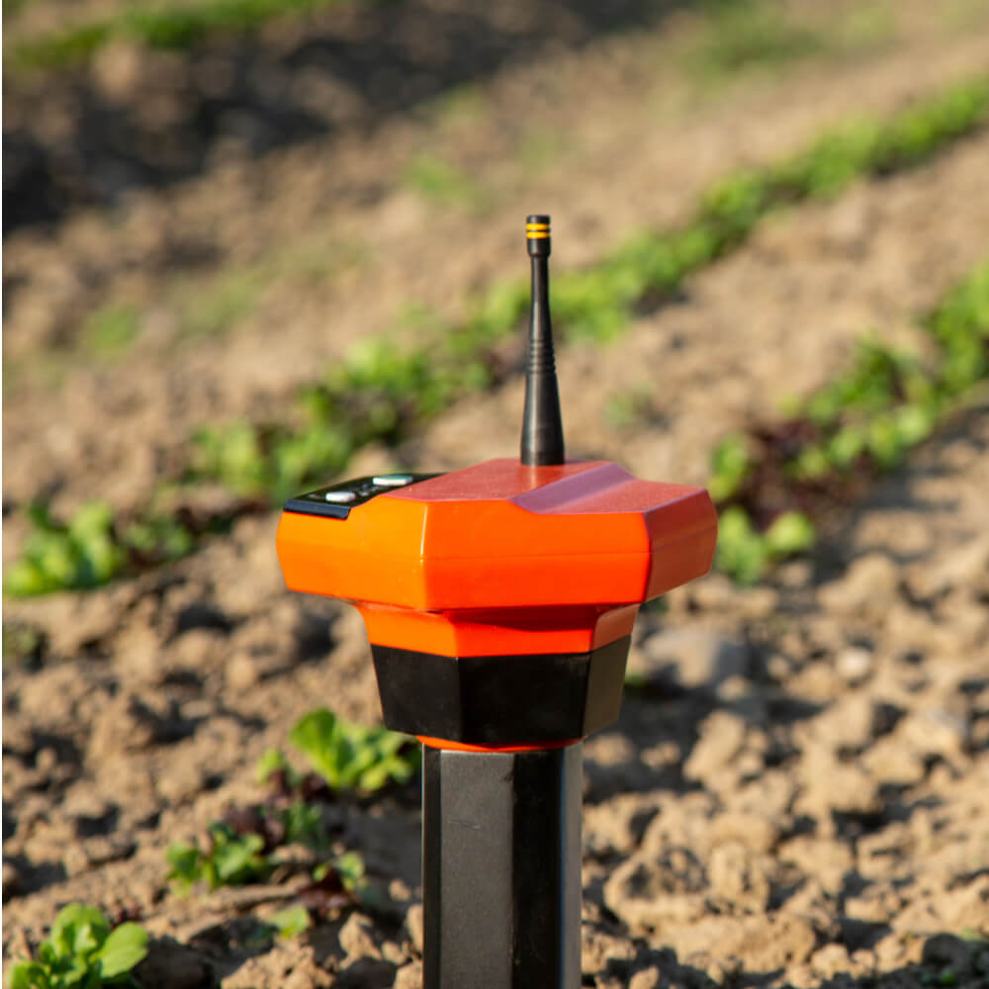
Smart Farming - Data Streaming Processing Hypothetically an IoT sensor metric real-time aggregator ~ 10 Million sensors – gps/temp/soil moisture ~ Million messages/minute ~ 99.999% reliability - Fast remote analysis and response pipeline
Massive IoT Example
Notes:
Data in motion – streaming!!!
Paypal
Verizon

Slide 3
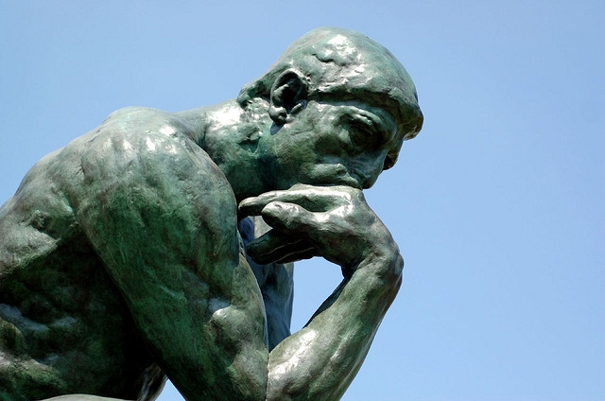
How do we build such a system?

Slide 4

Challenges for the modern technologist ( & MOORES LAW AND AMDAL RULES )
Create fast fault tolerant internet scale cloud systems to handle millions of transactions per day!

Slide 5
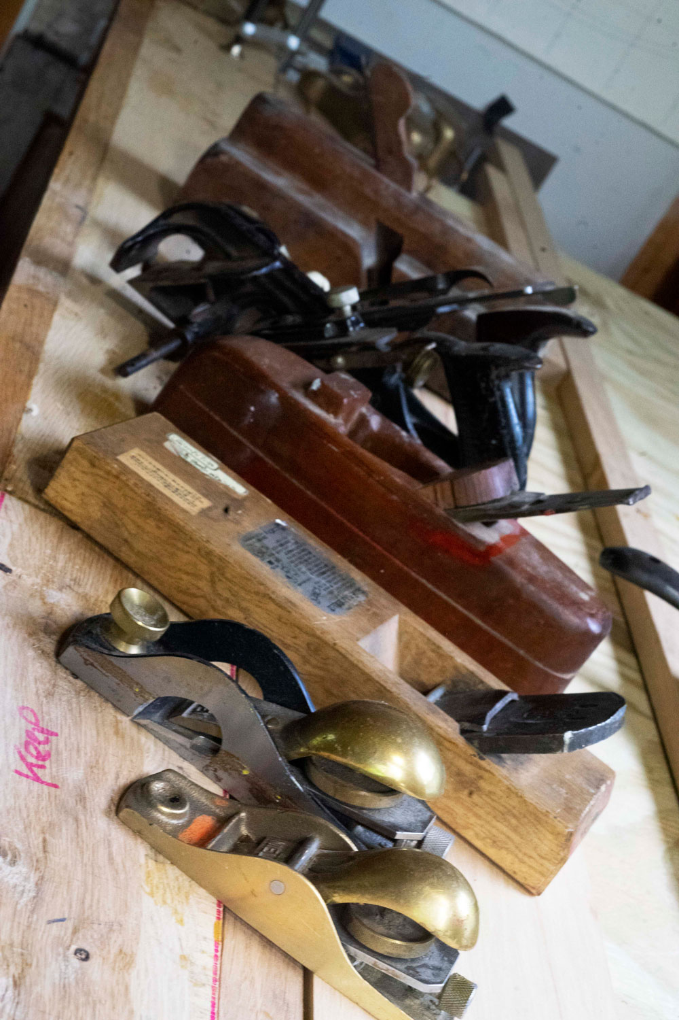
REACTIVE ARCHITECTURE
ACTOR MODEL OF COMPUTATION
AKKA
OpenShift
Notes:
Leave comfort zone of the Monolith – J2EE/ASP etc
Understand alternatives
Agenda today

Slide 6
Reactive Systems
Notes:
Model of Computation

Slide 7

What is Reactive?
The Reactive Manifesto
Published on September 16 2014. (v2.0)
Organizations working in disparate domains are independently discovering patterns for building software that look the same.
These systems are more robust, more resilient, more flexible and better positioned to meet modern demands. ... We call these Reactive Systems.
https://www.ReactiveManifesto.org/
Notes:
Asynchronous Backends

Slide 8
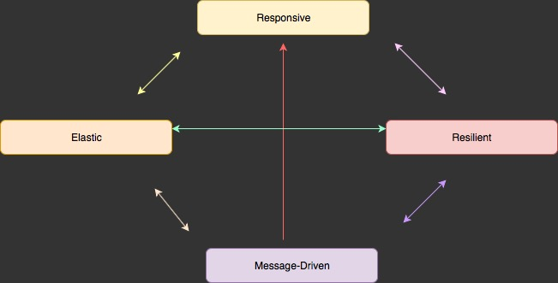
4 Reactive Principles
Notes:
Messages Async Streams

Slide 9
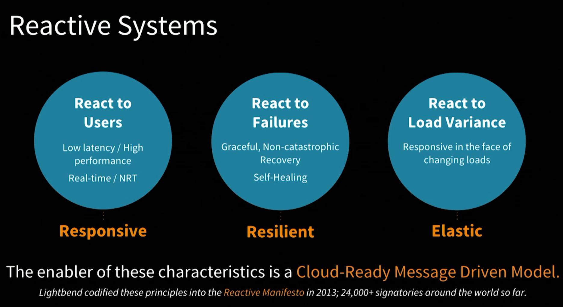
Let It Crash
Message Flow
Notes:
React to Failures
Isolation - bulkheads
Fault Tolerance – Isolation
Supervisory Tree
Expect failure in in distributed systems

Slide 10
Reactive Specification
Reactive Streams
An initiative to provide a standard for asynchronous stream processing with non-blocking back pressure. This encompasses efforts aimed at runtime environments (JVM and JavaScript) as well as network protocols.
https://www.reactive-streams.org/

Slide 11
Reactive Streams Implementations
RSocket (https://rsocket.io/)
Vert.x (https://vertx.io)
Pivotal – Reactor (https://projectreactor.io)
RxJava (http://reactivex.io)
MicroProfile (https://microprofile.io)
Notes:
“RSocket” application/networking protocol is a formal communication protocol that embraces the “reactive” principles. It enables the following symmetric interaction models via async message passing over a single connection:
request/response (stream of 1)
request/stream (finite stream of many)
fire-and-forget (no response)
channel (bi-directional streams)
It supports session resumption, to allow resuming long-lived streams across different transport connections. This is particularly useful for mobile⬄server communication when network connections drop, switch, and reconnect frequently.
- Netifi, Facebook, Pivotal, Alibaba Cloud, Lightbend (Reactive Foundation / Linux Foundation)
Vert.x - Eclipse Foundation, Red Hat, VMWare, Tim Fox – polyglot, event-driven framework – not Actor model, but Vertical
Pivotal – Reactor – Pivotal / Spring Reactive WebFlux makes use of the Reactor library – Reactive Streams
RxJava – RxJava1 and RxJava2 - RxJava2 more recent – supports Reactive Streams/Backpressure

Slide 12








The Reactive Foundation and RSocket
Open Source Layer 5/6 communication protocol based on Reactive Streams
Up to 10x faster than HTTP, using 90% less resources
New capabilities like streaming, resumption, cancellations ease development.
Reactive back pressure and flow control eliminates complex configuration.
Clients available for every language and platform (mobile, edge, IoT, etc).
Notes:
“RSocket” application/networking protocol is a formal communication protocol that embraces the “reactive” principles. It enables the following symmetric interaction models via async message passing over a single connection:
request/response (stream of 1)
request/stream (finite stream of many)
fire-and-forget (no response)
channel (bi-directional streams)
It supports session resumption, to allow resuming long-lived streams across different transport connections. This is particularly useful for mobile⬄server communication when network connections drop, switch, and reconnect frequently.
- Netifi, Facebook, Pivotal, Alibaba Cloud, Lightbend (Reactive Foundation / Linux Foundation)

Slide 13
IBM Reactive options
Reactive is showing up here
Appsody
Eclipse Vert.x (https://vertx.io)
IBM Cloud Pak for applications
OpenJDK/J9
Spring Framework (v5 > )
Spring Web Reactive Framework
Notes:
Appsody – developer framework to create apps using Application Stack – cloud native -> ready to deploy to k8s
One of the stacts is Vert.x - Eclipse Foundation, Red Hat, VMWare, Tim Fox – polyglot, event-driven framework – not Actor model, but Vertical
Event driven and non-blocking. Concurrency!! Polyglot – Java, JS, Groovy, Scala and Kotlin Ruby
Cloud Pak for applications – > Spring Web Reactive Framework –
Non blocking async event driven – backpressure - pipeline -

Slide 14
Actors
Notes:
Model of Computation

Slide 15
What is an actor? – Carl Hewitt 1977
Compute
Storarge
Communicate
Universal Primitive of concurrent digital computation
Notes:
Communicate via Messages
Concurrently
Isolated Storage
Alonzo Church created lambda calculus
- 1930 influenced LISP programming lang and functional programming

Slide 16
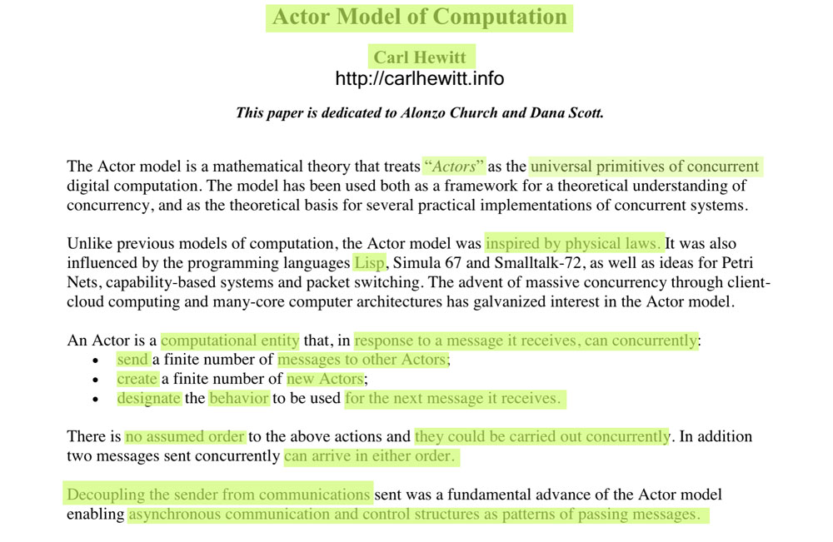
Actor Model Origins - 1977
Notes:
https://arxiv.org/ftp/arxiv/papers/1008/1008.1459.pdf
https://en.wikipedia.org/wiki/Lambda_calculus
Alonzo Church created lambda calculus
- 1930 influenced LISP programming lang and functional programming

Slide 17
OBJECT ORIENTED
ACTORS
Everything Object
Encapsulation – limited – requires locks when multiple threads enter the same block of data
Message passing
Synchronous
Blocking
Calls Typically in one Process/ 1-n Threads
Threads Hard to understand and manage properly and heavyweight
Everything Actor
Message Passing - Mailboxes
Asynchronous
Non-Blocking
Calls in local or remote Actor systems via network
Actors Lightweight
Notes:
Actors / Lightweight v.s. Threading
I was amazed to see the difference, I observed that with my system I was able to spawn maximum ~2000 threads (live at a time) only But with the same system I was able to spawn ~500,000 actors of scala.
Both programs used around 81MB of Heap memory of JVM.

Slide 18
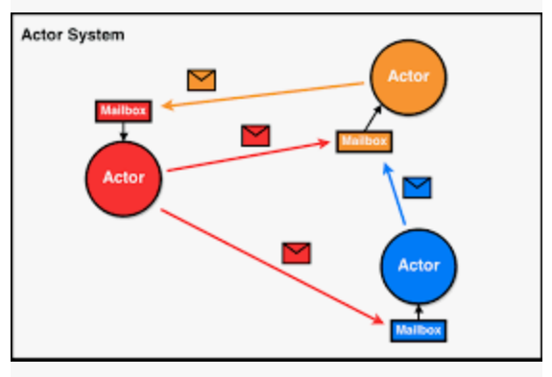
Actor System / Ecosystem
Notes:
1 ant is no Actor
Startup Actor system – 3 actors get initialize root (/) /user /system
Inbox Queue
Sequential processing in an individual actor
Specialized Q’s
Prioriy
Message types only
1 only till done

Slide 19
In response to a message that it receives, an Actor can:
make local decisions
create more actors
send more messages
determine how to respond to the next message received
Notes:
.

Slide 20
Actor Resilience or Fault tolerance? Actors who spawn children can Supervise their child Actors
Notes:
1 ant is no Actor
Inbox Queue
Sequential processing in an individual actor
Specialized Q’s
Prioriy
Message types only
1 only till done

Slide 21
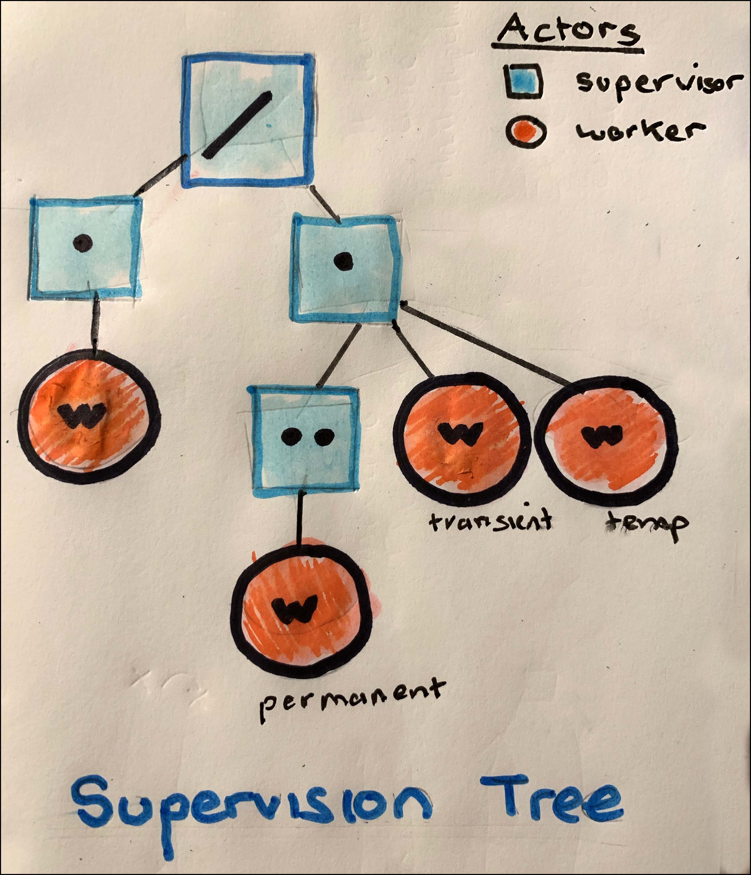
Supervisor actions:
Stop
Start
Restart
TERM/Kill
Message Flow
Supervised
Each child worker actor can be one of three types:
permanent - is always restarted when it dies
transient - is restarted if it dies abnormally
temporary is never restarted.
Notes:
The model (Erlang) is based on the idea of workers, supervisors, and a supervision tree. ... A supervisor can restart a worker if something goes wrong. The supervision tree is a hierarchical arrangement of an application into workers and supervisors.
Each child can be one of three types:
a permanent child is always restarted when it dies
a transient child is restarted if it dies abnormally
a temporary child is never restarted.

Slide 22
Advantages of Supervision Business Logic Separated from Exception/Error Handling logic
Notes:
Not silver bullet
Still cases for threads – Office Apps / Photoshop iTunes etc

Slide 23
Actor based frameworks
Actor Model Proposal 1977
Erlang 1982
Scala 2001
Akka 2009(beta) – 2019(stable)
Akka.NET
Microsoft – Orleans 2018? 5961 github commits
…
Notes:
Time line
Orleans - Distributed Virtual Actor Model http://dotnet.github.io/orleans

Slide 24
Akka
Notes:
Lightbend open source
Scala Martin Odersky
Akka
Lagom – opinionated – may be easier to build Microservice(system)

Slide 25

Distributed Actor System
building fault tolerant transaction processing
applications
resilient
elastic
distributed
real-time
message driven
Notes:
Scala -
Akka
Customers
Paypal 1 Billion Tx/Day

Slide 26
Demo simple hello world Greeter

Slide 27
Akka – distributed Actor System (2-n)
Supervisor
Spawn()
Greeter
Print(“HELLO WORLD”)
doAction(Msg.GREET)
Received()
Notes:
Comminicate via Messages via inbox /queues
Concurrently
Out of order
At Most Once ( i.e. may not be delivered – network failure or receiver down )
At Least Once ( i.e. receiver may need to deal with duplication )
Exactly once - impossilbe

Slide 28
All Things Reactive – a peek into Reactive Java Slides :: 2019 Mary Grygleski Twitter: @mgrygles IBM Developer Advocate Java & Reactive Grant Steinfeld Twitter: @gsteinfeld IBM Developer Advocate JVM & Blockchain

Slide 29
Akka – Messaging Protocols
AKKA:TCP
AKKA: (UDP)
Gossip

Slide 30
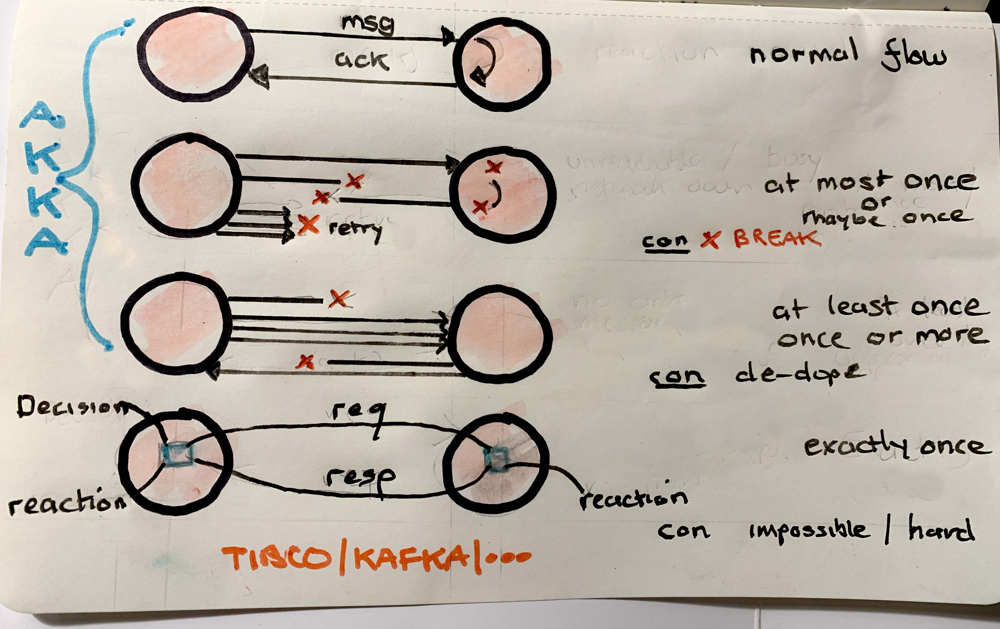

Slide 31
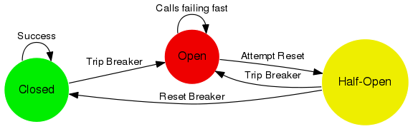
Circuit Breaker
Notes:
A circuit breaker is used to provide stability and prevent cascading failures in distributed systems. These should be used in conjunction with judicious timeouts at the interfaces between remote systems to prevent the failure of a single component from bringing down all components.
Akka Streams - backpressure is also an option

Slide 32
Akka Actor – Message types
Regular
Specialized
Manage actors
Broadcast
PoisonPill / Kill
Priority Flags
Notes:
Can modify Message Inbox too

Slide 33
Akka Actors – 4 Routing Strategies
Scatter Gather First Complete
Consistent Hashing Pool
Distributed Pub/Sub
Dynamic Pool
Notes:
Get 1st Response from from First actor that Completes it’s action - Ignore the subsequent replies
Cache One Actor sends messages to the SAME Actor
Remote pub sub – all actors get the SAME message
Scale out / horizontally – Remote

Slide 34
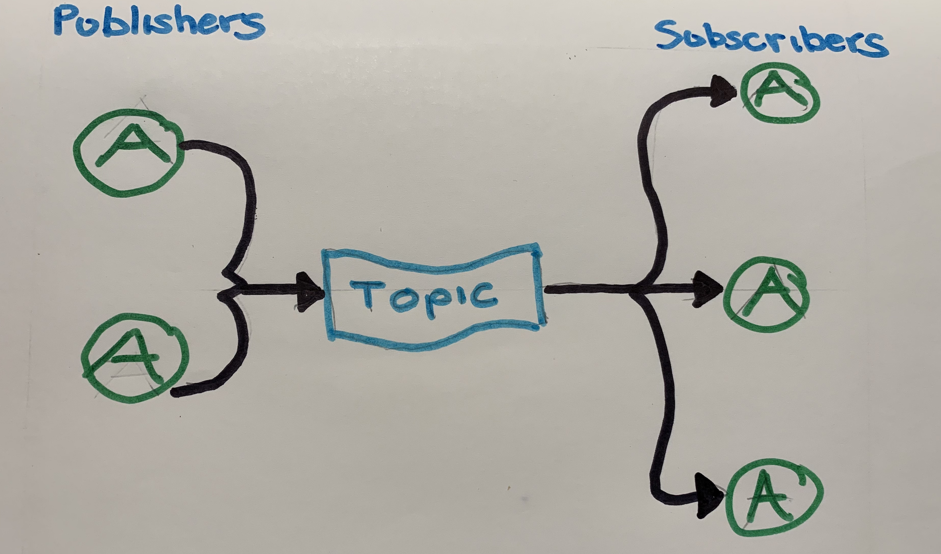
Akka Cluster - Distributed Publish/Subscribe
Notes:
All subscriber Actors get the same message

Slide 35
Remoting
Akka Actors - Distributed Options
Clustering
Location Known
Peer to Peer
Akka:tcp://<<actorID>>@34.56.55.202:7676
Lookup via ActorSelection( ) by traversing
Actor Hierarchical Tree
No Need for Address just UPID/Name
Distributed Cluster of different JVMs ( on K8s/OS pods)
Akka:tcp://LookingUpRemoteActors@localhost:2553/user/<<actorID>>
Logical Member of a cluster
Notes:
Akka - Distributed
- Location Transparancy
Transparent if Actor is local or remote

Slide 36
Akka Actor Cluster
Node
Cluster
Leader/Guardian
Seed/User
FailureDetector
Notes:
Leader – singleton – membership and state management
Seed – where new actors spawn from
Failure detector –System component of Actor Cluster System Auto detects UNREACHABLE Actors
Uses the Phi Accural Failure Algorithm to Detect downed or missing actors

Slide 37
Actor Lifecycle -states
Join
Up
Leave
Exit
Down
Removed
Notes:
Join
Up – regular operating state
Leave
Exit – removal process
Down – Actor Node no longer part Cluster decision making processes
Removed – Actor Node no longer a MemberOf acluster

Slide 38
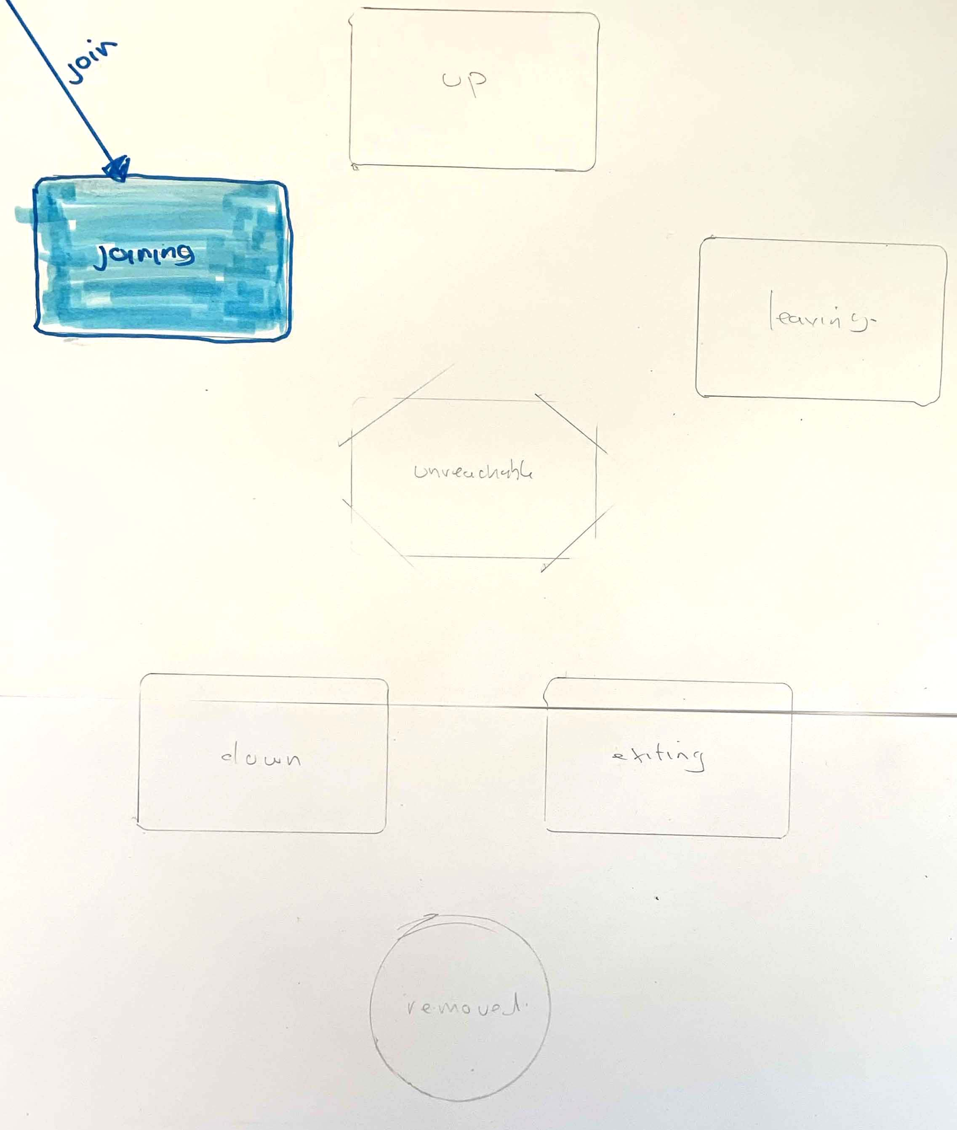
key
L.A. Leader Action
(fd) Fault Detection
Node States in an Akka Cluster
IBM Developer Advocacy

Slide 39
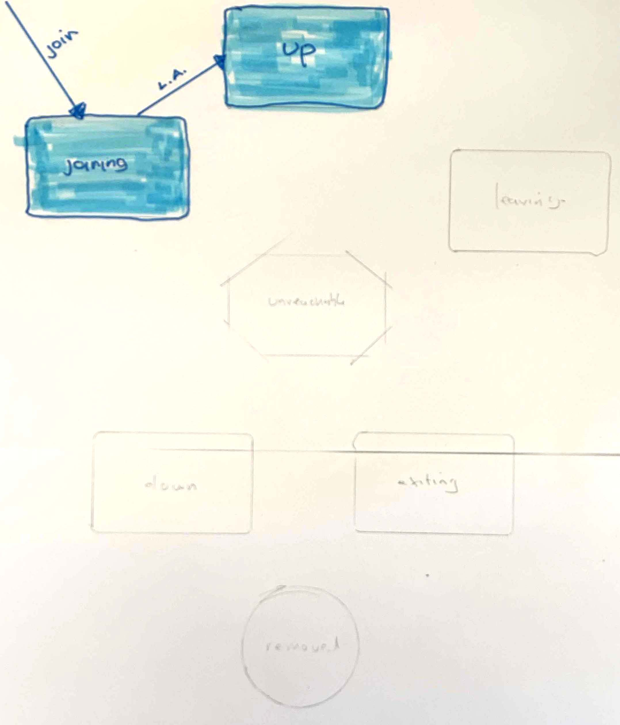
key
L.A. Leader Action
(fd) Fault Detection
Node States in an Akka Cluster
IBM Developer Advocacy

Slide 40
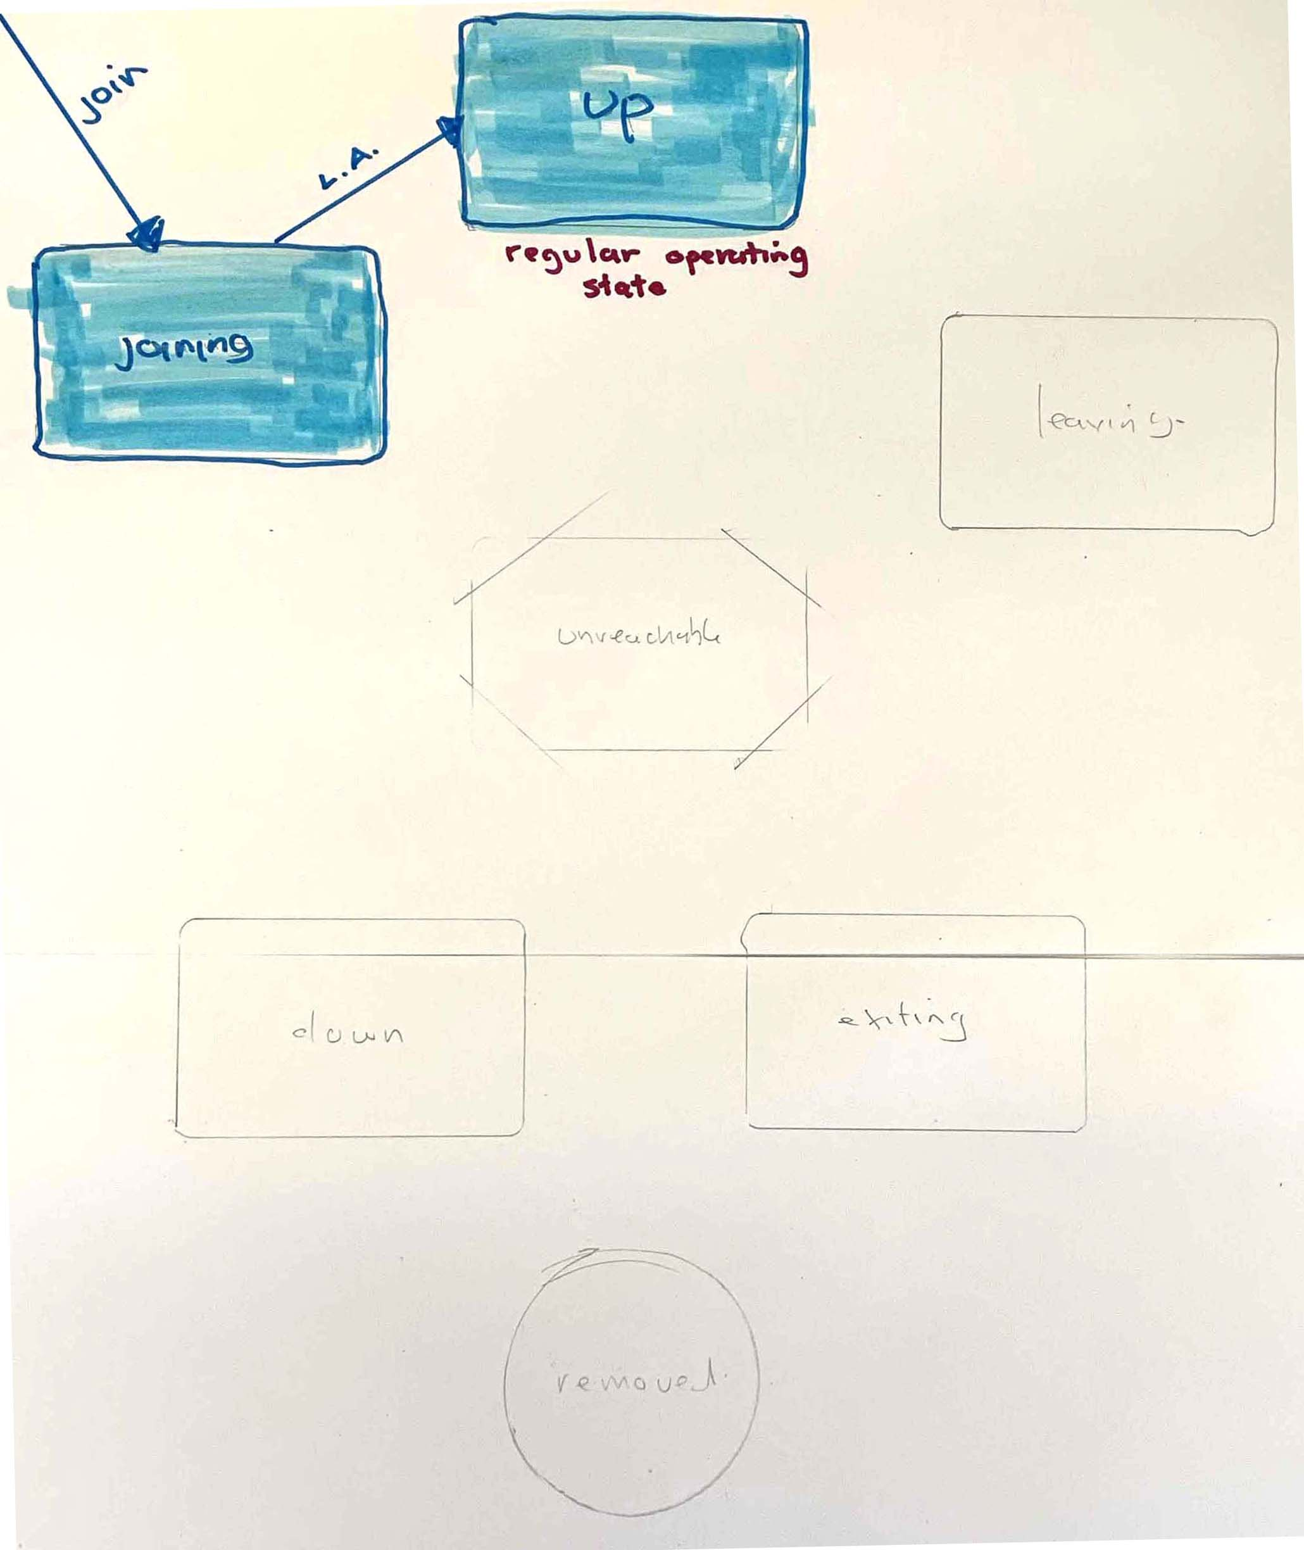
key
L.A. Leader Action
(fd) Fault Detection
Node States in an Akka Cluster
IBM Developer Advocacy

Slide 41
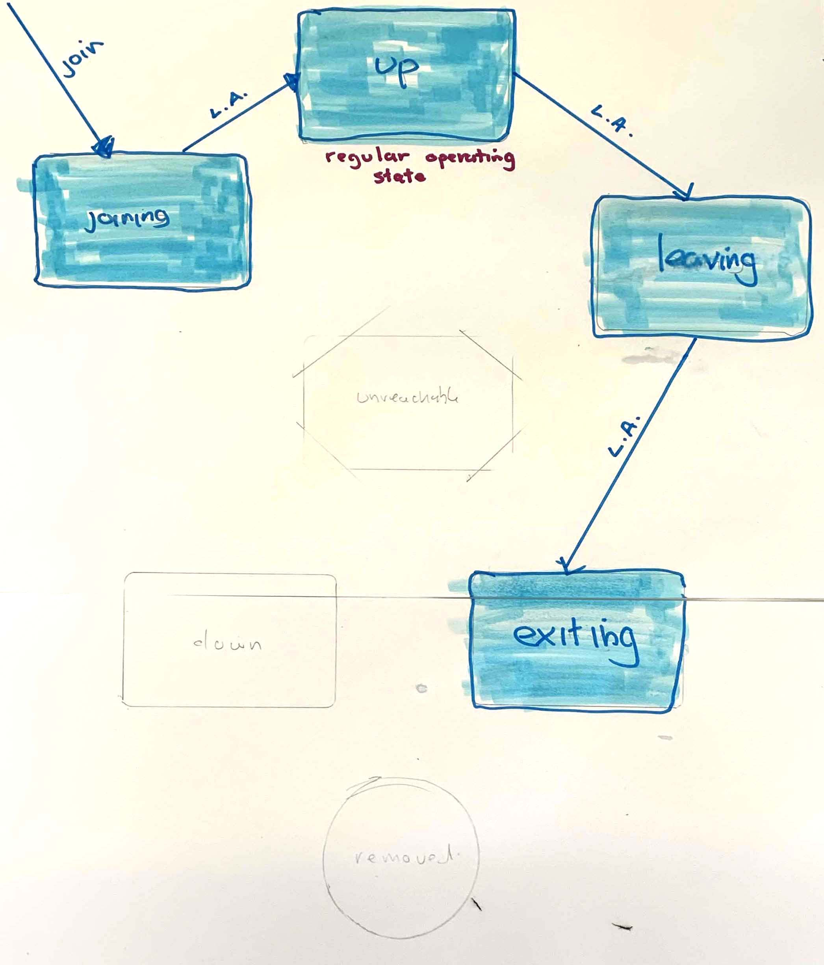
key
L.A. Leader Action
(fd) Fault Detection
Node States in an Akka Cluster
IBM Developer Advocacy

Slide 42
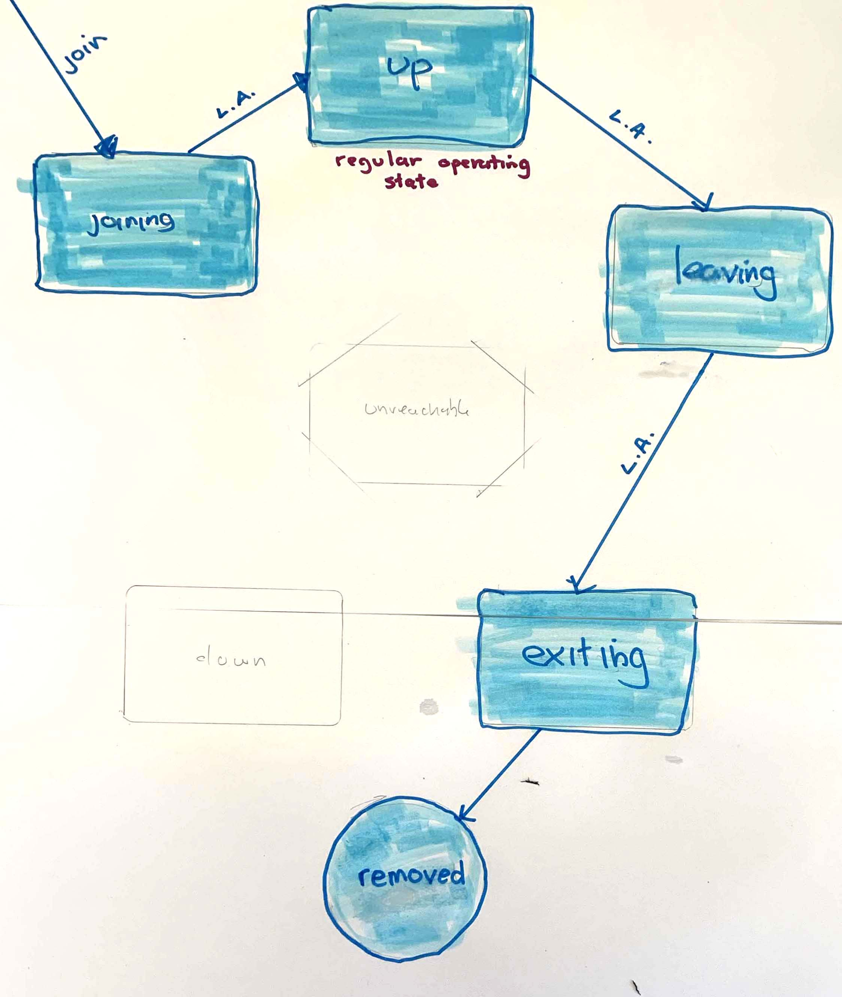
key
L.A. Leader Action
(fd) Fault Detection
Node States in an Akka Cluster
IBM Developer Advocacy

Slide 43
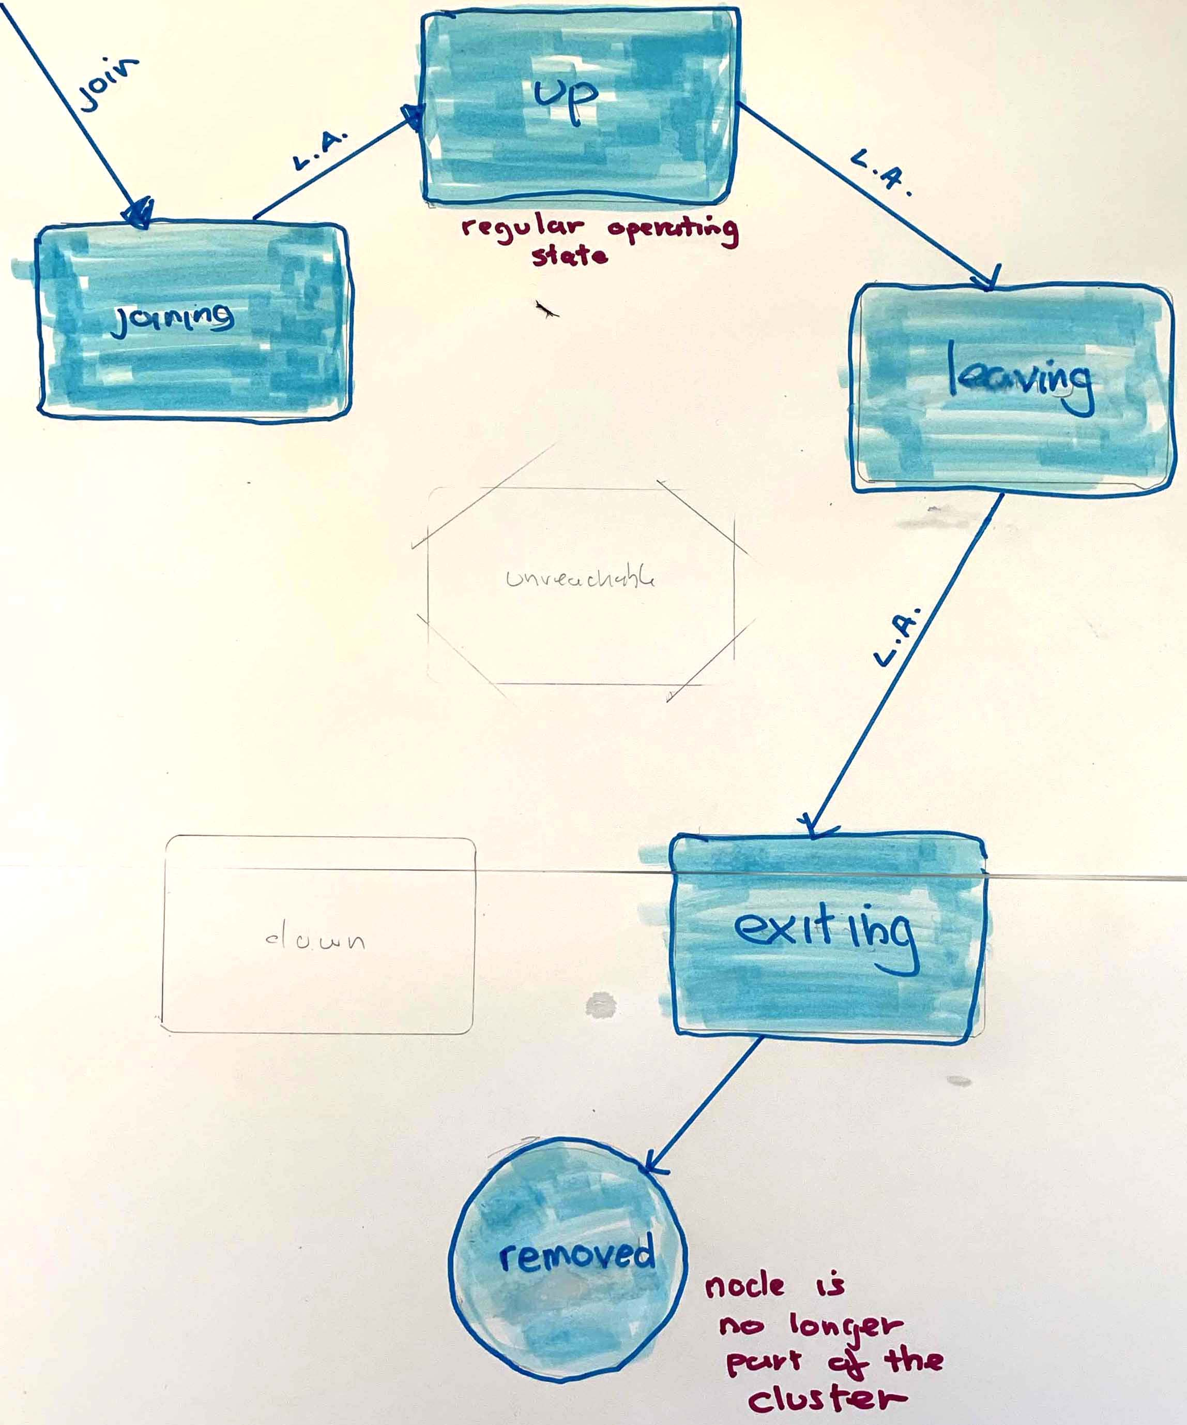
key
L.A. Leader Action
(fd) Fault Detection
Node States in an Akka Cluster
IBM Developer Advocacy

Slide 44
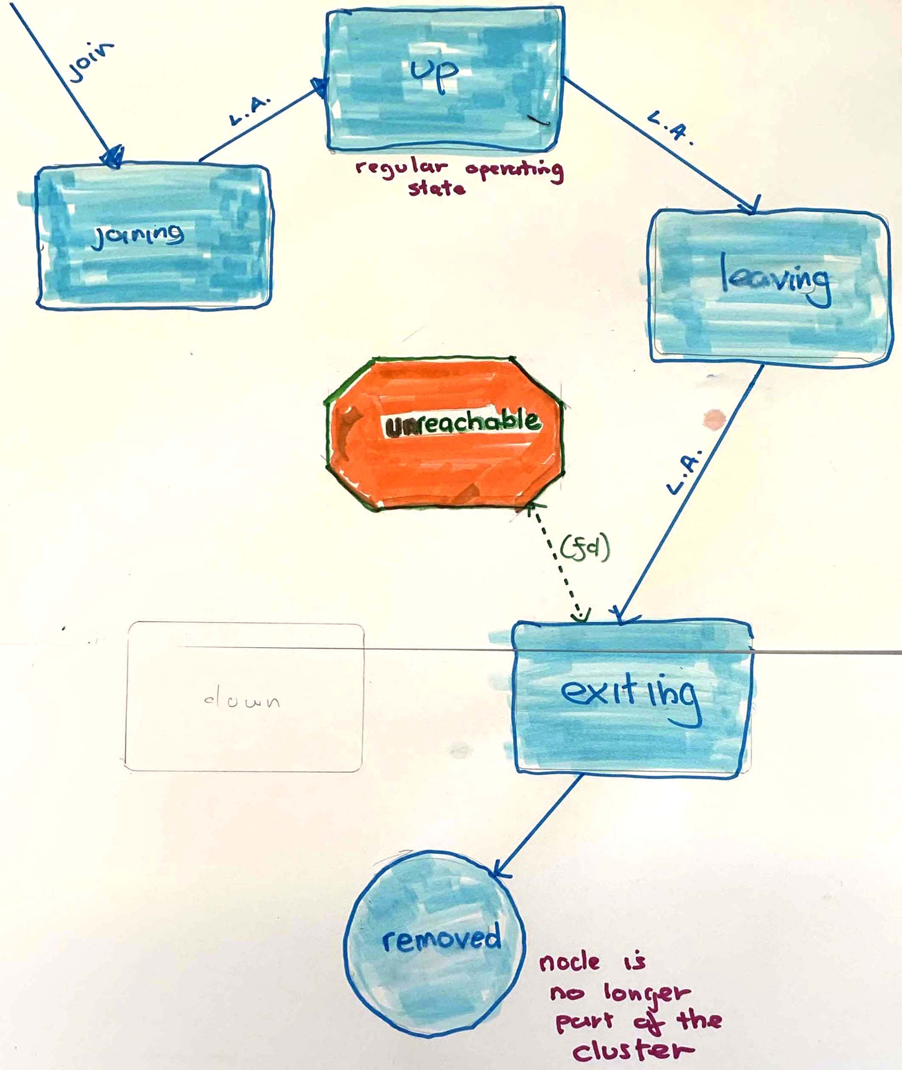
key
L.A. Leader Action
(fd) Fault Detection
Node States in an Akka Cluster
IBM Developer Advocacy

Slide 45
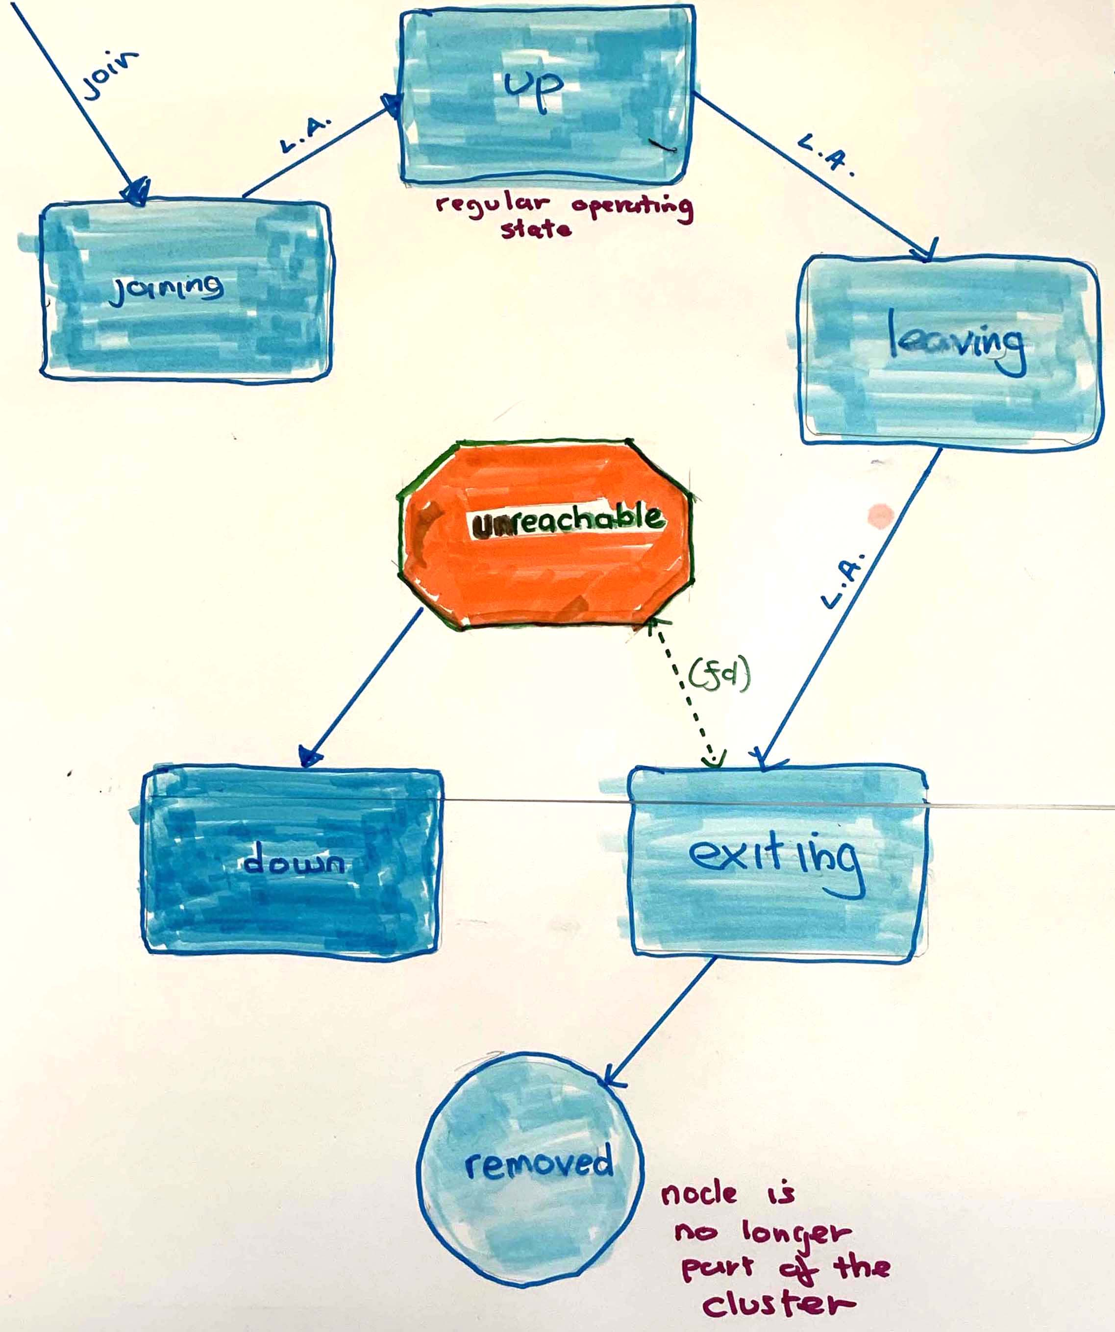
key
L.A. Leader Action
(fd) Fault Detection
Node States in an Akka Cluster
IBM Developer Advocacy

Slide 46
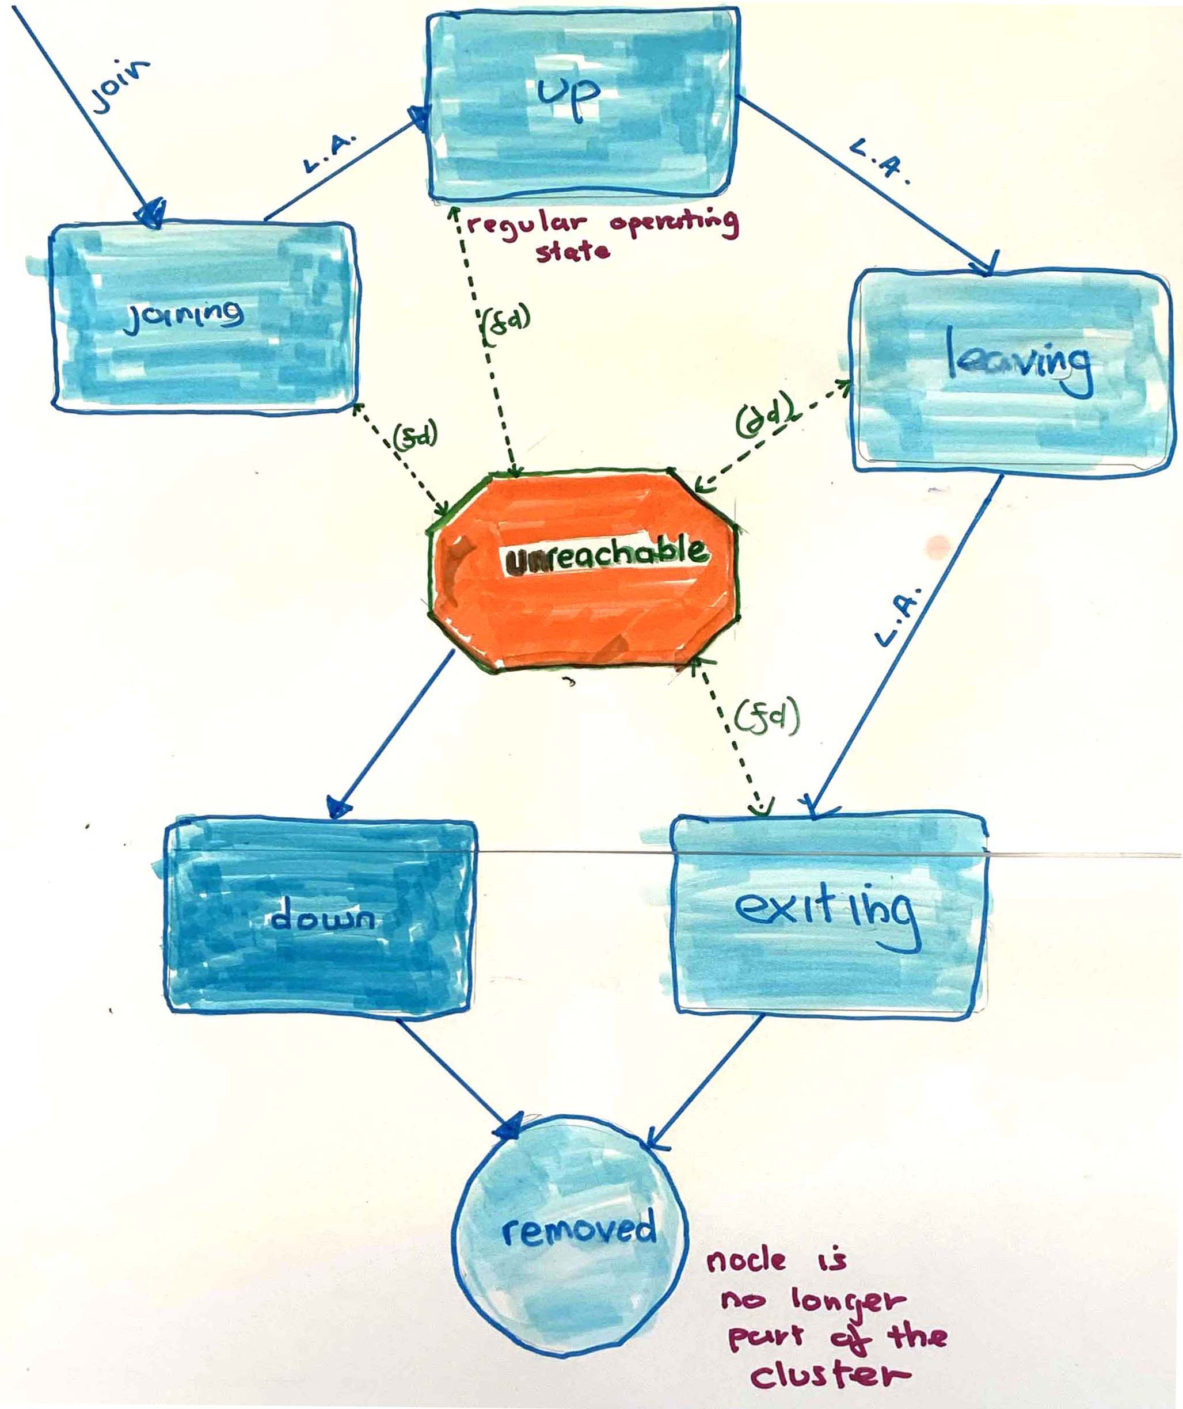
key
L.A. Leader Action
(fd) Fault Detection
Node States in an Akka Cluster
IBM Developer Advocacy

Slide 47
Akka – Ecosystem Tools
Sharding
HTTP
Data Sharing
Kafka Publishing
Circuit Breaker
Notes:
Circuit Breaker – stop too much flow in – throttle – backpressure (add resources)

Slide 48
Partitioning by Sharding
Auto dist Node Actors across multiple Clusters/JVM
These Node Actors === Entity Nodes
UniqueId
STATEFUL
Event Sourcing
CQRS
Notes:
Because scale out/horizontally
This is all because of cluster sharding – the essence of Actor systems ARE
SO amazing
☺

Slide 49
SHARED DATA
CRDTs
Eventual Consistency
If Collisions
Resolved with
Monotonic merge function Algorithm
Notes:
Conflict Free Replicated Datasets – google docs sharing
Irony – because we said isolation and state is NOT shared
But in some case we need to share data between actor

Slide 50
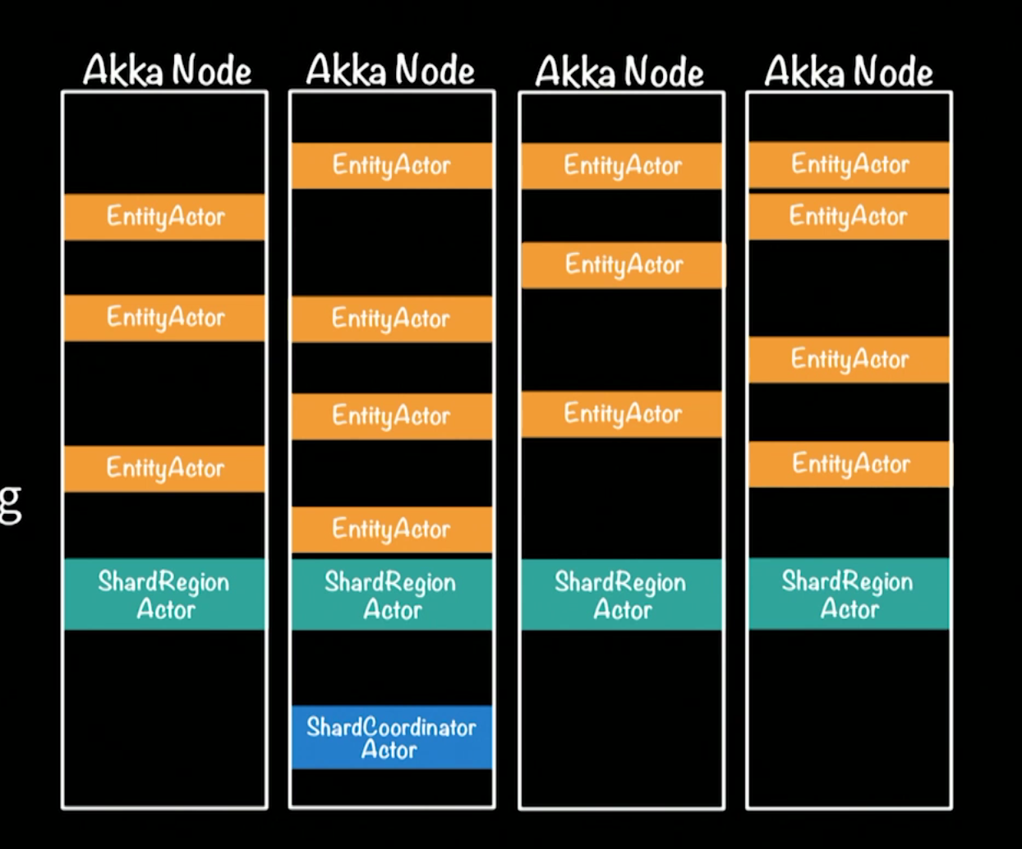
Akka Entity Distributed sharding
Notes:
Moer interesting shard region dist messages to right place in ecosystem
Entity only place where change – actor is the concurrency ‘multi-thrading’ only a single actor ( eg #67 )
Akka persistence – Cassandra etc -
But event log
Write side
Read side

Slide 51
KAFKA - publishing
Publish to Kafka event - topic
Down stream DB processing
Keeps blocking operation
Out of way fast data flow processing
CQRS – Q making materialized views

Slide 52
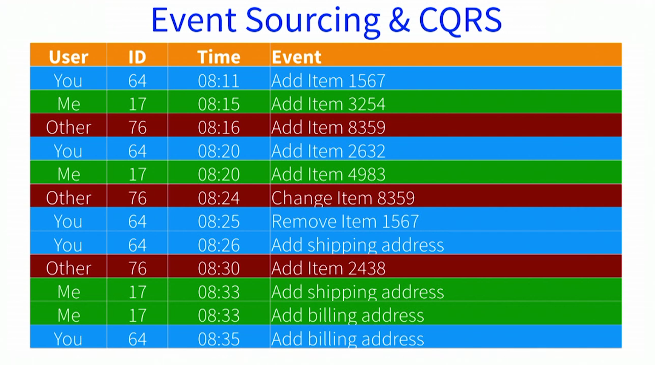
Event sourcing and CQRS
Command Query Responsibility Segregation
Message Flow
Notes:
Used a lot at customers
:
Store events not a db table
To get current state – replay events ( including –ve data like deletes – more interesting to data scheinctists )

Slide 53
Akka – Design Patterns
Master Slave Work Pulling
Ordered Termination
Circuit Breaker
Notes:
Few interesting ones:
Worker – pases on messages when actors are ready for more
Deterministic termination

Slide 54
Crop circle chrome demo https://bit.ly/ 2lSrLza
Notes:
Crop circle
2 eL lower case eS r eL upper zed a
Show viz 1st
OpenShift pod gui console on IBM cloud (vm)
Scale pods up / down
Show pods oc show pods / node
Show code?
Tail log

Slide 55
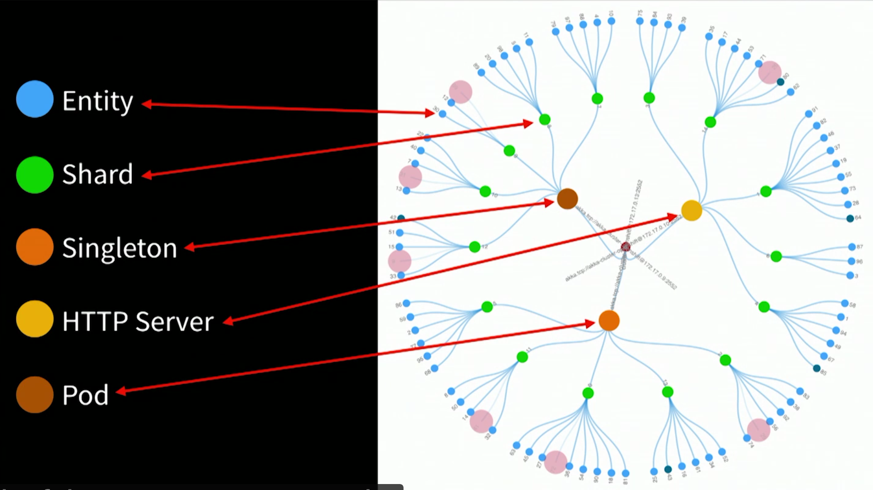
Demo – Actor types in an Actor Ecosystem
Visualization
D3
Websockets
Notes:
Singleton – Leader
Entity out on the perimeter Blue dots
Stateful actor ENTITY
Represents State ( Event Log / Event source CQRS – epiphany ! No more bottle next DB!!!
– bank account | shopping cart | IoT device

Slide 56
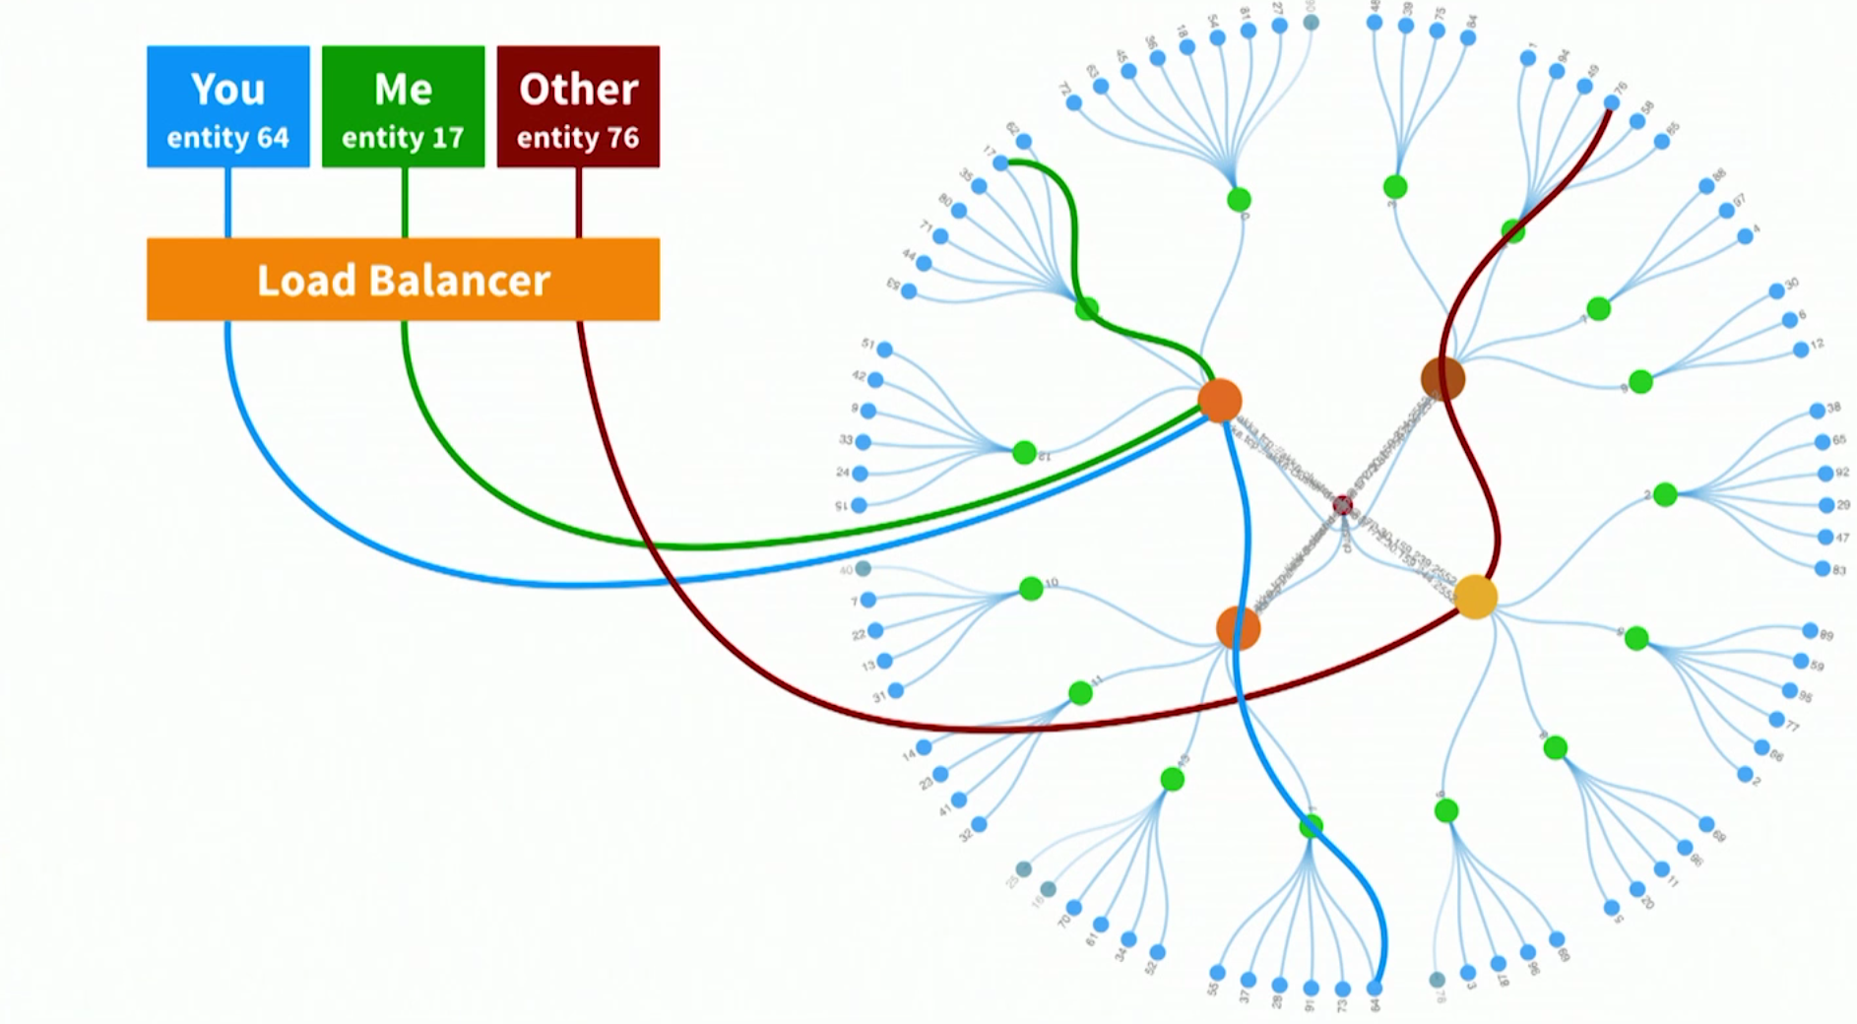
Cluster entity actors
Message Flow
Notes:
Client doing stuff on specific entity
Client does something on entity 64
Quick lookup – is this in this jVM – in other JVm request fwd
Blue line what shard
Is this mine
Is actor is alive
If yes fwd
If not creates actor – recovers state from DB –
Or most likely from
Event sourcing or CQRS

Slide 57
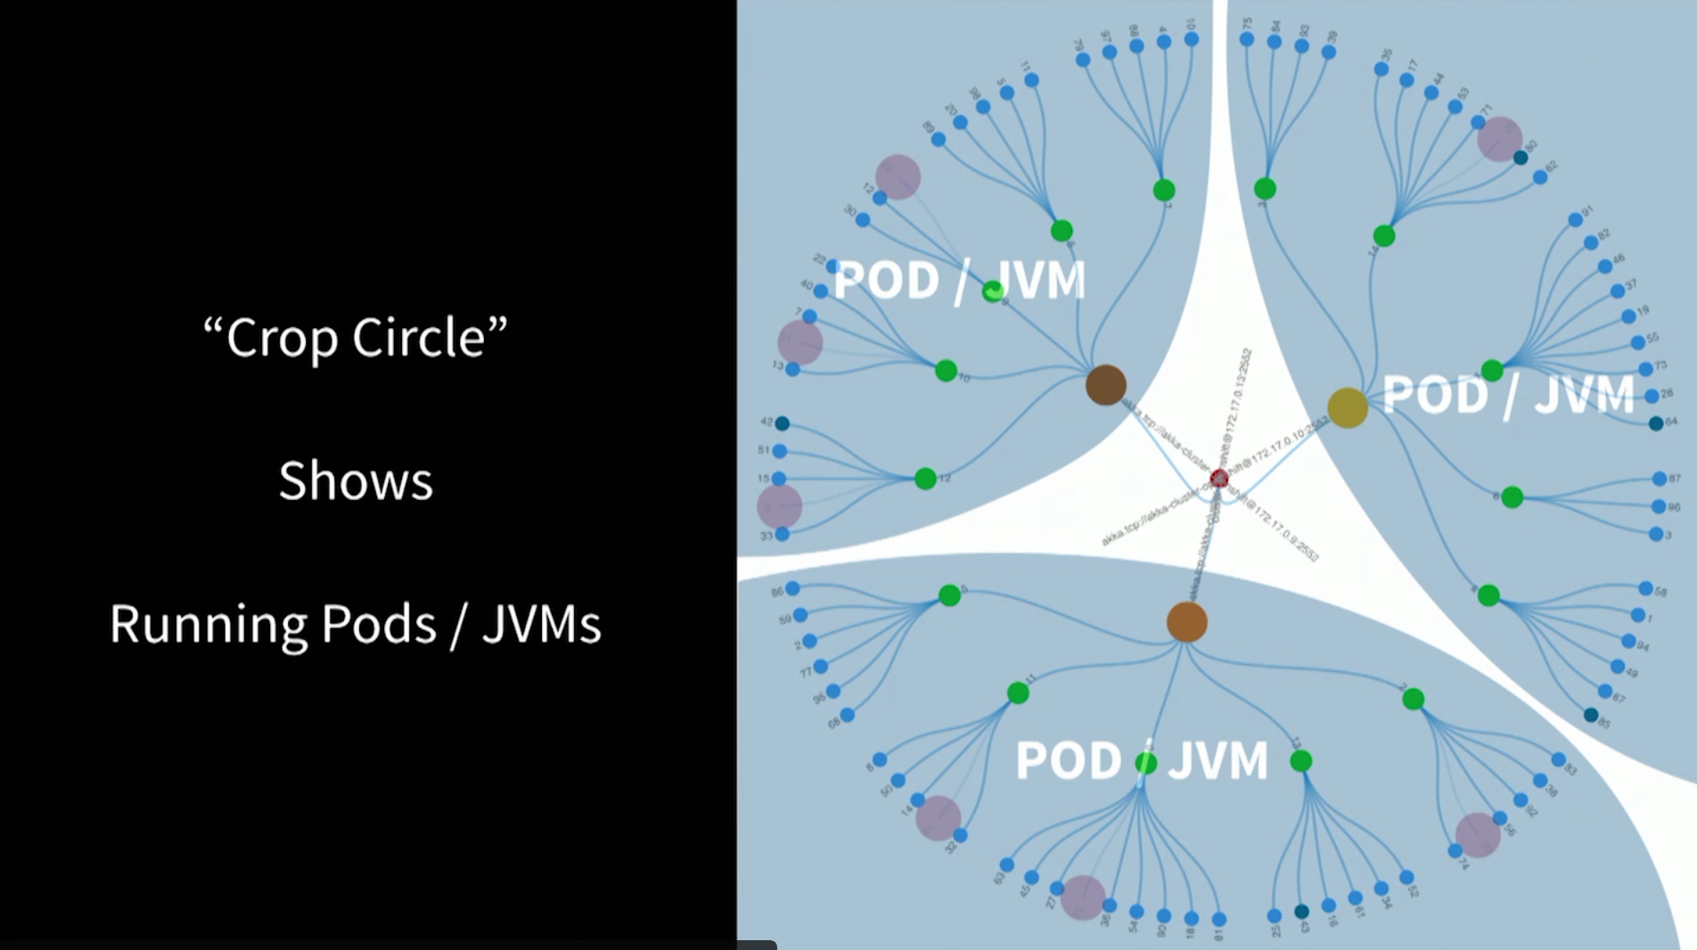
Demo – d3 visualization
Each OpenShift Pod runs a single JVM

Slide 58

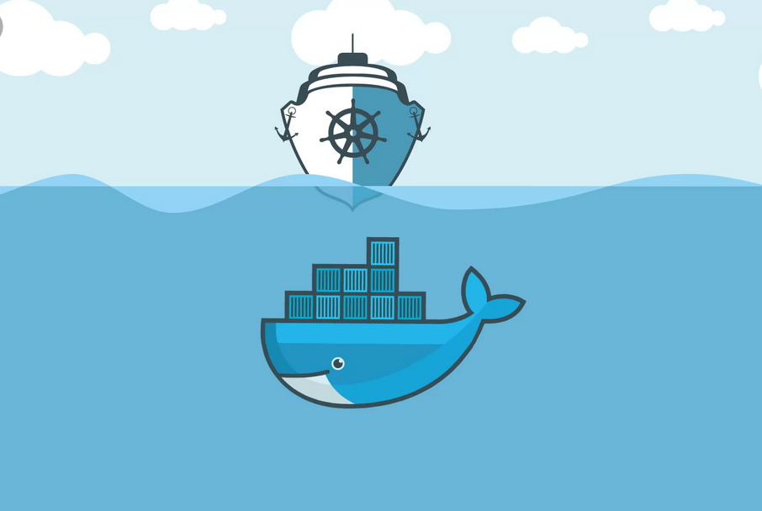

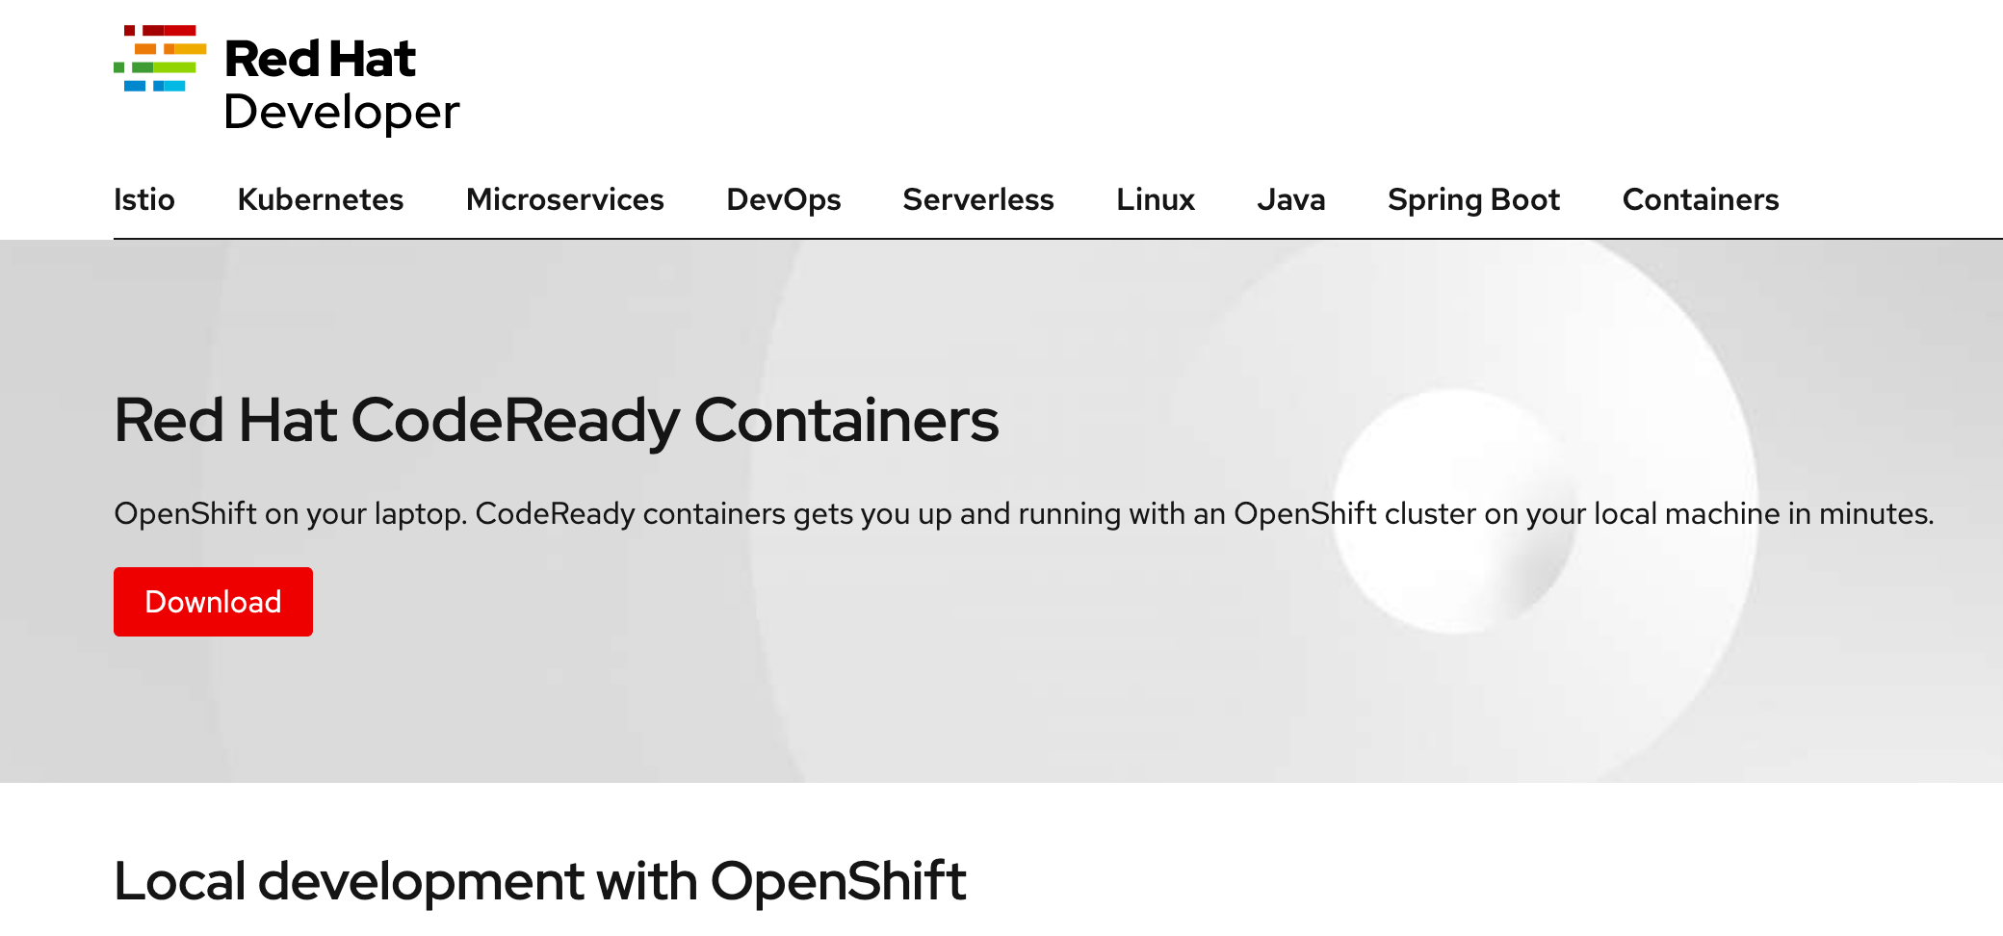





Dev => Deployment `options`
OpenShift (version 3)
OpenShift (version 4)
Orchestration
Container
Base Image
Ubuntu
Alpine
RedHat UBI
Notes:
Base image: Linux – Ubuntu Alpine or RedHat Universal Base Image(UBI)
Container Podman or Docker or Singularity
Where our Stateful Microservice
Akka Actor application will run and be managed by

Slide 59
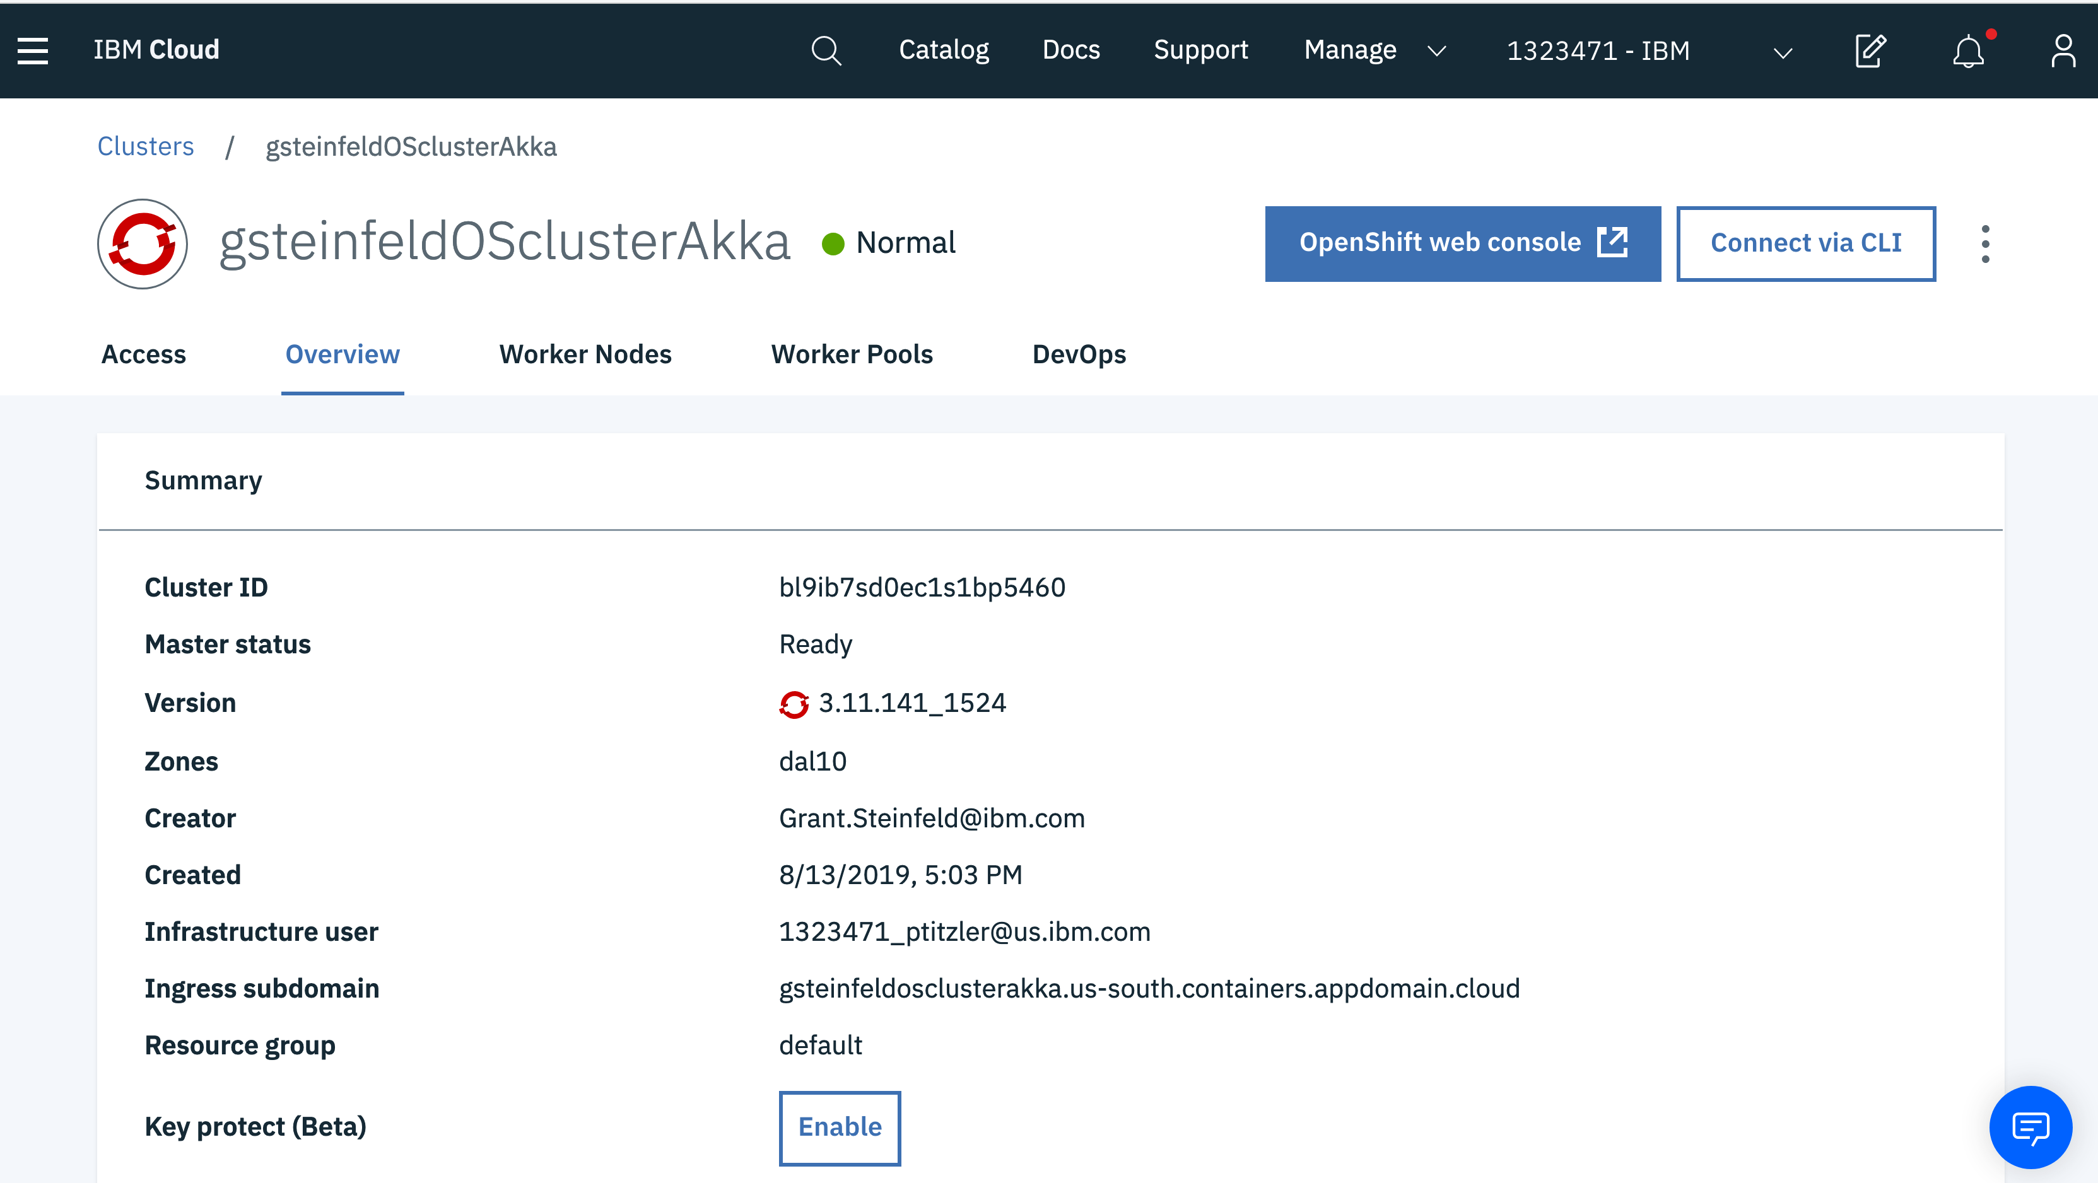

Slide 60
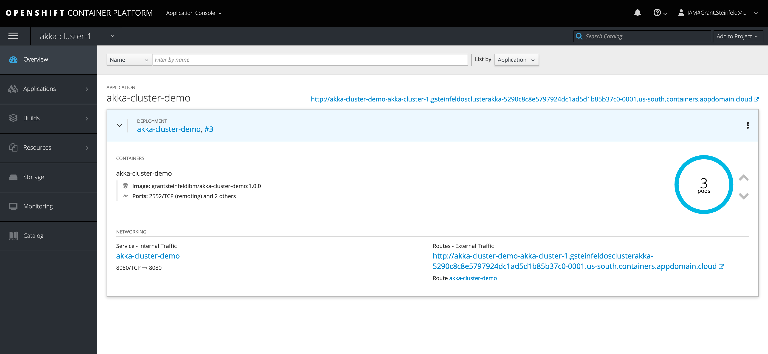

Slide 61
Resources full demo code in this presentation https://github.ibm.com/mary-grygleski/vtcc_akka_helloworld - Mary Grygleski https://github.com/mckeeh3/akka-java-cluster-kubernetes - Hugh McKee Reactive Architecture and programming https://developer.ibm.com/technologies/reactive-systems/ https://www.reactivemanifesto.org/ Actor Model of Computation - Scalable Robust Information Systems Carl Hewitt https://arxiv.org/ftp/arxiv/papers/1008/1008.1459.pdf Akka Actors https://doc.akka.io/docs/akka/current/actors.html How Akka Works: 'At Most Once' Message Delivery – Hugh McKee https://www.lightbend.com/blog/how-akka-works-at-most-once-message-delivery

Slide 62
Resources Reactive Microsystems - The Evolution Of Microservices At Scale: Free O'Reilly Report By Jonas Bonér https://www.lightbend.com/blog/reactive-microsystems-the-evolution-of-microservices-at-scale-free-oreilly-report-by-jonas-boner Akka Cookbook by Piyush Mishra, Héctor Veiga Ortiz https://www.oreilly.com/library/view/akka-cookbook/9781785288180/ CQRS/EVENT SOURCING https://martinfowler.com/bliki/CQRS.html - Martin Fowler https://cqrs.files.wordpress.com/2010/11/cqrs_documents.pdf - Greg Young Supervision Principles in Erlang http://erlang.org/documentation/doc-4.9.1/doc/design_principles/sup_princ.html appsody https://appsody.dev/ Customizing Appsody stacks: An Introduction – stacks include Eclipse Vert.x - IBM - Yan Koffman https://developer.ibm.com/articles/customizing-appsody Spring Web Reactive support in Spring Framework (v5) https://docs.spring.io/spring-framework/docs/5.0.0.M1/spring-framework-reference/html/web-reactive.html

Slide 63
Resources IBM OpenShift https://www.ibm.com/cloud/openshift RedHat - CodeReady Containers https://developers.redhat.com/products/codeready-containers Minishift https://www.okd.io/minishift/ Docker Altenatives Docker vs Singularity vs Shifter https://tin6150.github.io/psg/blogger_container_hpc.html Podman https://podman.io Singularity https://sylabs.io/

Slide 64
Resources Reactive Streams https://www.reactive-streams.org Reactive Foundation (Under the Linux Foundation) https://reactive.foundation RSocket (”Reactive Socket”) https://rsocket.io RxJava (ReactiveX) http://reactivex.io Pivotal Project Reactor (Spring Web Reactive) https://projectreactor.io Eclipse Vert.x https://vertx.io Eclipse MicroProfle https://microprofile.io

Slide 65

Q&A
Q&A

Slide 66


Thank You!
@gsteinfeld
Sign up onto the IBM cloud platform
https://cloud.ibm.com
https://github.com/grant-steinfeld
https://developer.ibm.com/profiles/grant.steinfeld
Get this presentation slide deck at
https://github.com/Grant-Steinfeld/actors-akka-2019
@mgrygles
https://github.com/mgrygles
https://developer.ibm.com/profiles/mary.grygleski

